Slide 1

3.6 GHz Benchmarks
Slovakia
221903168
338985736
0
0
0
Strategic Finance Europe

Slide 2

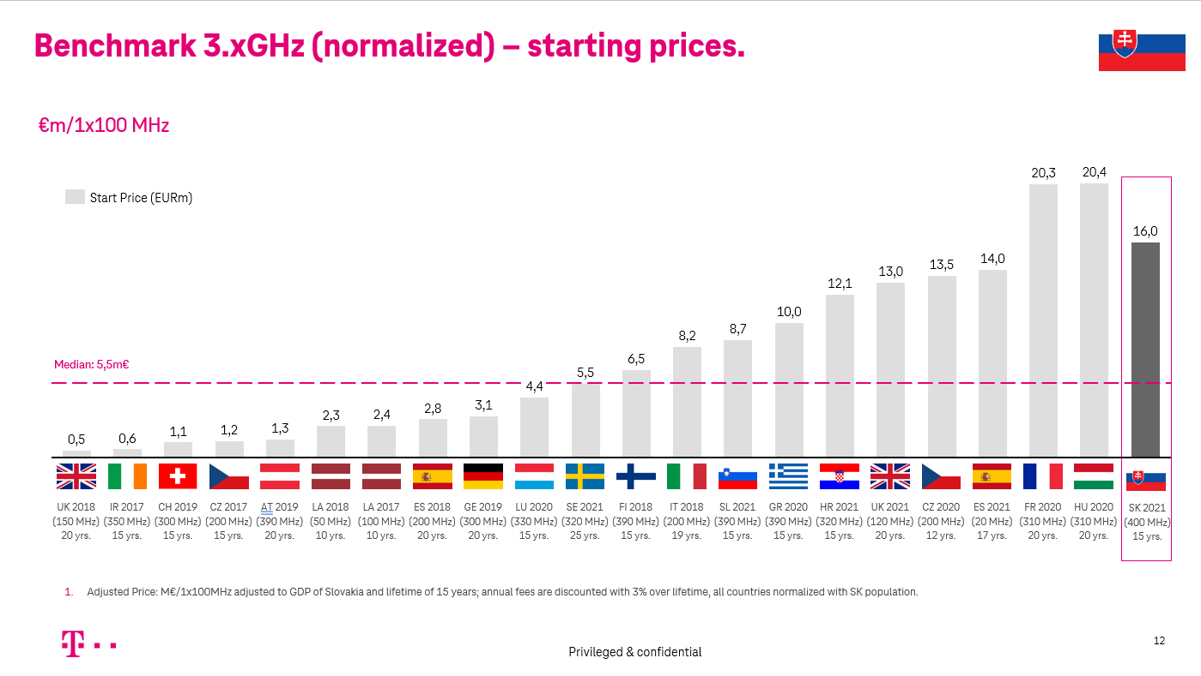

Executive summary: We believe that setting start prices must consider historic starting prices in European auctions and annual fees.
Spectrum benchmarking approach
Median benchmarks of starting prices²
The slide deck shows spectrum reserve price and annual fees bench-marks in the 3.xGHz band across Europe since 2017
We normalized multiples with adjustments to GDP per capita¹ of Slovakia and a standardized license lifetime of 15 years
Based on normalized multiples and adjusted for Slovakian population¹, we show lot prices with respective median values
We are convinced that starting prices are the only valid benchmarking reference to calculate the starting price for the upcoming spectrum auction → pls. see slide #11
When setting reserve prices, we deem it necessary to consider the annual fees and include them in the benchmarking. Annual fees are a real burden as they impact EBITDA and reduce the financial leeway for investment in 5G infrastructure
Overall, reserve prices should be moderate and incentivize investments in the network by rollout commitments
3.x GHz:
5,5m€ / 100MHz
All GDP and population data in this slide deck are provided by The World Bank.
Lot prices based on adjusted Multiple: m€/1x100MHz in 3.xGHz adjusted to GDP of Slovakia and lifetime of 15 years; all countries normalized with Slovakian population.
2
– confidential –

Slide 3

Normalization of multiples:
Brief introduction

Slide 4
Calculation logic of spectrum multiples.
What does the formula: Price/MHz/Pop mean?
Unadjusted Multiple: €/MHz/pop
Adjusted multiple: Duration & GDP
Price
MHz
Population
Duration
GDP adj.
    Price reached in the auction by particular operator in the respective auction for the spectrum block and license duration
    Volume of the spectrum in the particular band the operator has acquired for the price
    Note: FDD spectrum is multiplied 2
    Population being covered by the respective spectrum. Population data are retrieved from The World Bank.
    Note: for legacy bands, nationwide coverage is assumed
    Duration of the spectrum license, (usually 15 or 20 years). In this document we standardized to 15 years.
    GDP allows comparison of stronger economies with weaker econo-mies among the European countries. GDP data are retrieved from The World Bank.
4
– confidential –

Slide 5
Observations in spectrum spending
Correlation of spectrum spend and wireless score

Slide 6
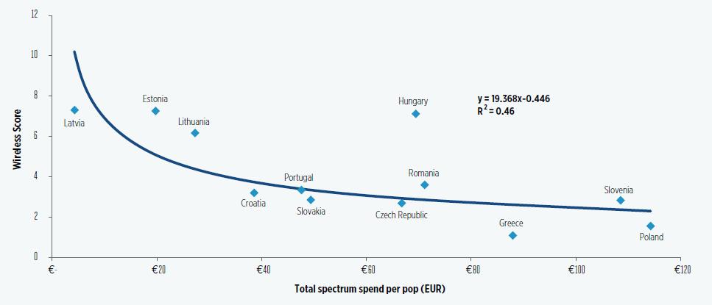
High total spectrum spend correlates with low wireless score in middle income European countries.
Source:
NERA Economic Consulting with data from OpenSignal.com and Telegeography GlobalComms database, presented by GSMA: “Effective Spectrum Pricing in Europe: Policies to support better quality and more affordable mobile services”, September 2017
6
– confidential –

Slide 7
Starting prices as the relevant guidance for benchmarking

Slide 8
Suggested approach is to consider benchmarking of auction reserve prices in Europe per band since 2017.
For the purpose of calculating and determining the starting price for the award of the radio frequency spectrum in the upcoming auction, we suggest considering benchmarking tender procedures for the same bands in other European countries.
We suggest to consider in the benchmarking the tender procedures applied in Europe from 2017 onwards, since then 3.x GHz spectrum was awarded for mobile usage. When applying benchmarking, the price that is included in the sample for a segment of 1x100 MHz in the 3.x GHz band is calculated per MHz and per capita per country. This price is adjusted by applying key indicators, such as a standardized license lifetime of 15 years per band and the purchasing power of Slovakia´s GDP compared to the indicators in the other European countries where rights have been assigned.
8
– confidential –

Slide 9
To calculate starting prices by means of benchmarking, we consider only starting prices the relevant input factors.
  When applying benchmarking to calculate starting prices, it is appropriate to include only the starting prices of the historic tender procedures in the sample. Final auction prices are not suitable for setting starting prices. Therefore, we provide starting price benchmarks as fair price points to give guidance.
  Setting higher reserve prices based on final auction price benchmarks may increase the risk of unsold spectrum.
  Higher reserve prices based on final auction price benchmarks may also discourage participation. To the benefit of a wide spectrum usage and the swift deployment of 5G infrastructure in Slovakia, an auction should not improperly preclude bidders from having the opportunity to participate in the auction.
  Basically, lower starting prices favor investment into infrastructure and a swift rollout in Slovakia.
  There is no automatism that high starting prices lead to high final prices (e.g. 2100MHz in Hungary in 03/2020 with a starting price multiple of 0.115 and a final price multiple of 0.123 EUR/MHz/Pop). At the same time, low starting prices can result in very high final prices if we take e.g. 2100MHz in Germany 2019 with a starting price multiple of 0.006 and a final price multiple of 0.243.
  Final auction prices do not provide the fair benchmarking level for reserve prices as they strongly depend on auction-specific conditions and are a result of auction dynamics. Key conditions that strongly impact final prices are esp. auction designs with inherent risk of price driving, transparency, caps, number of bidders, new entrants, obligations and their absence, behavior of bidders, spectrum scarcity, etc.
  Adopting a conservative approach to setting reserve prices provides room for relevant price discovery in the auction which allows bidders to improve individual expectations about the likely value of the spectrum and adjust their bidding strategy accordingly. Higher starting prices based on final price benchmarks would reduce leeway for fair pricing mechanisms.
    01
    02
    03
    04
    05
    06
    07
9
9
– confidential –

Slide 10
3.X GHz Price Benchmarks

Slide 11

















Benchmark 3.x GHz (normalized) – starting prices.
M€/1x100 MHz
Start Price (EURm)
Median: 5,5m€
UK 2018
(150 MHz)
20 yrs.
IR 2017
(350 MHz)
15 yrs.
CH 2019
(300 MHz)
15 yrs.
CZ 2017
(200 MHz)
15 yrs.
AT 2019
(390 MHz)
20 yrs.
LA 2018
(50 MHz)
10 yrs.
LA 2017
(100 MHz)
10 yrs.
ES 2018
(200 MHz)
20 yrs.
GE 2019
(300 MHz)
20 yrs.
LU 2020
(330 MHz)
15 yrs.
SE 2021
(320 MHz)
25 yrs.
FI 2018
(390 MHz)
15 yrs.
IT 2018
(200 MHz)
19 yrs.
SL 2021
(390 MHz)
15 yrs.
GR 2020
(390 MHz)
15 yrs.
HR 2021
(320 MHz)
15 yrs.
UK 2021
(120 MHz)
20 yrs.
CZ 2020
(200 MHz)
12 yrs.
ES 2021
(20 MHz)
17 yrs.
FR 2020
(310 MHz)
20 yrs.
HU 2020
(310 MHz)
20 yrs.
SK 2021
(400 MHz)
15 yrs.
Adjusted Price: M€/1x100MHz adjusted to GDP of Slovakia and lifetime of 15 years; annual fees are discounted with 3% over lifetime, all countries normalized with SK population.
11
Privileged & confidential

Slide 12
3.X GHz Multiple Benchmarks

Slide 13
Benchmark 3.xGHz (normalized) – starting prices.
€/MHz/Pop
Start Price
Median: 0,0100 EUR/MHz/Pop
UK 2018
(150 MHz)
20 yrs.
IR 2017
(350 MHz)
15 yrs.
CH 2019
(300 MHz)
15 yrs.
CZ 2017
(200 MHz)
15 yrs.
AT 2019
(390 MHz)
20 yrs.
LA 2018
(50 MHz)
10 yrs.
LA 2017
(100 MHz)
10 yrs.
ES 2018
(200 MHz)
20 yrs.
GE 2019
(300 MHz)
20 yrs.
LU 2020
(330 MHz)
15 yrs.
SE 2021
(320 MHz)
25 yrs.
FI 2018
(390 MHz)
15 yrs.
IT 2018
(200 MHz)
19 yrs.
SL 2021
(390 MHz)
15 yrs.
GR 2020
(390 MHz)
15 yrs.
HR 2021
(320 MHz)
15 yrs.
UK 2021
(120 MHz)
20 yrs.
CZ 2020
(200 MHz)
12 yrs.
ES 2021
(20 MHz)
17 yrs.
FR 2020
(310 MHz)
20 yrs.
HU 2020
(310 MHz)
20 yrs.
SK 2021
(400 MHz)
15 yrs.
Adjusted EUR/MHz/Pop adjusted to GDP of Slovakia and lifetime of 15 years; annual fees are discounted with 3% over lifetime, all countries normalized with SK population.
13
Privileged & confidential

